Slide 1


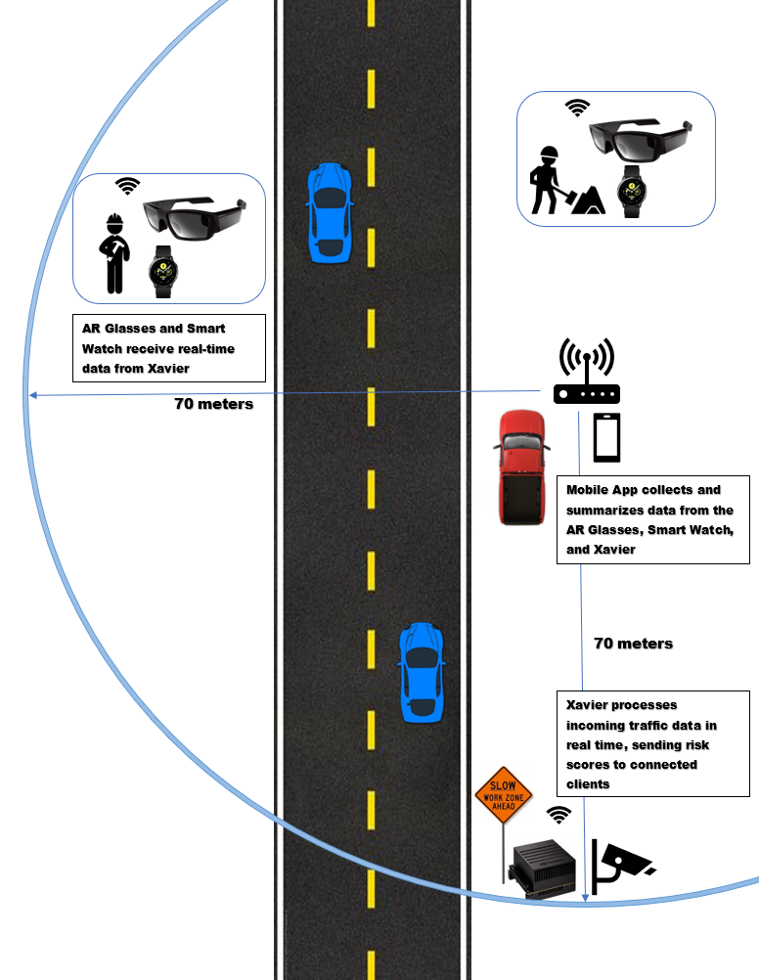
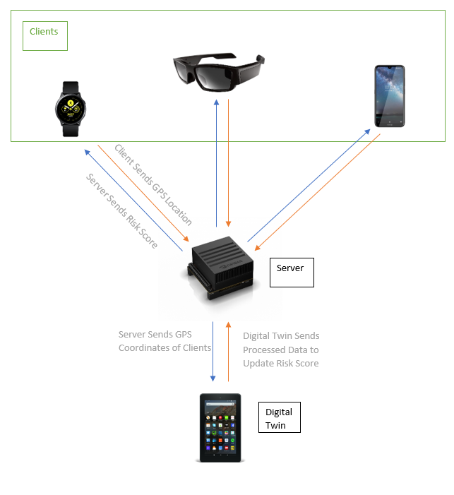
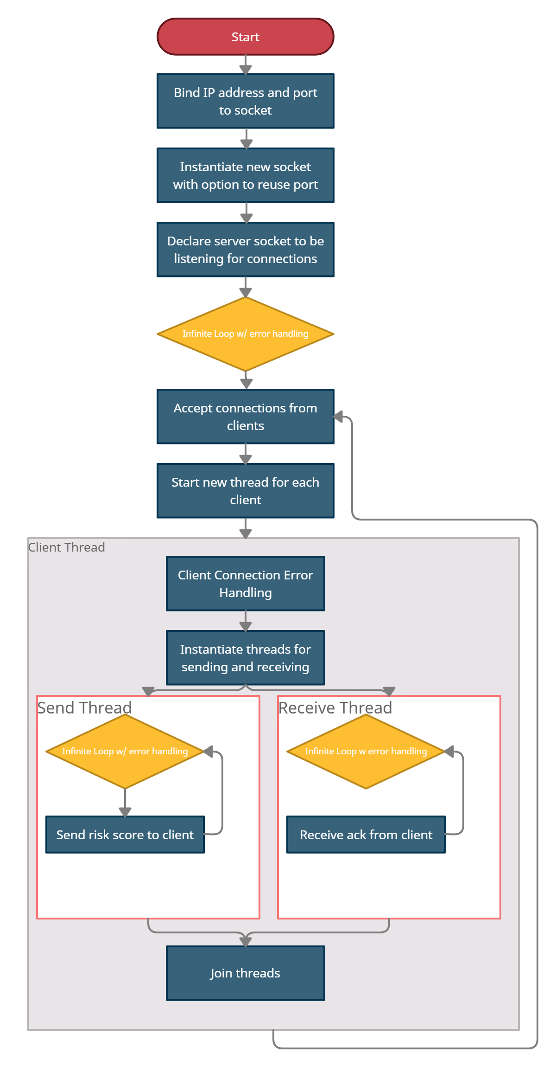
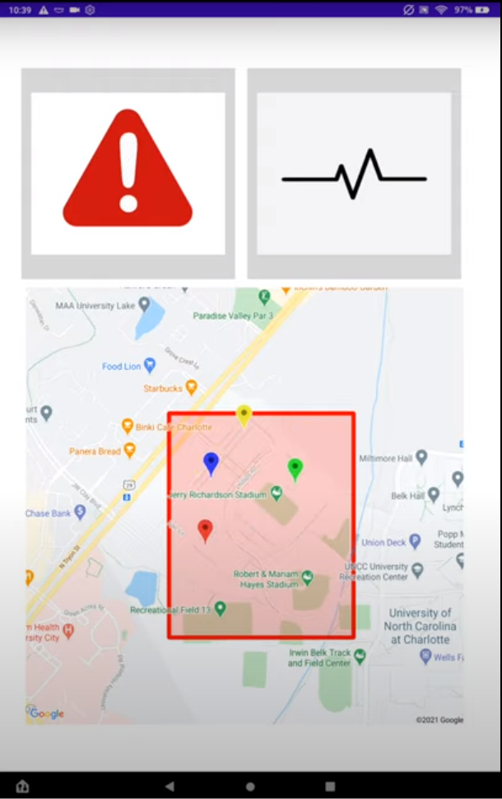
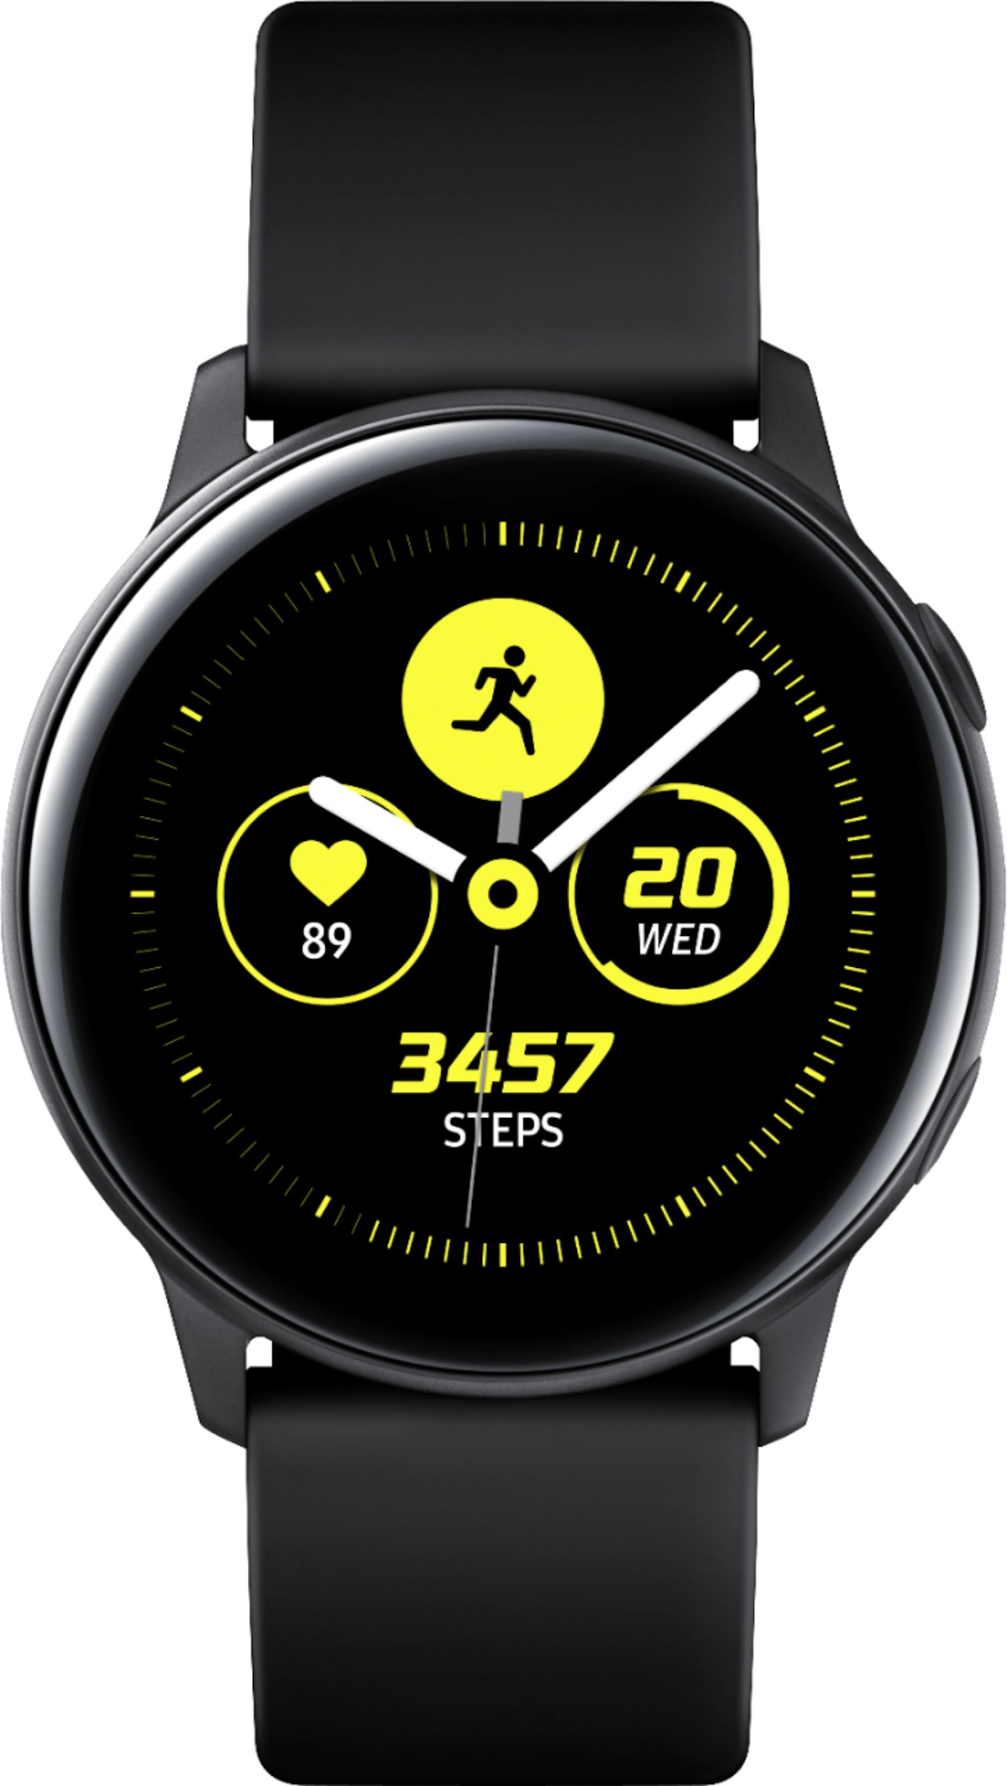
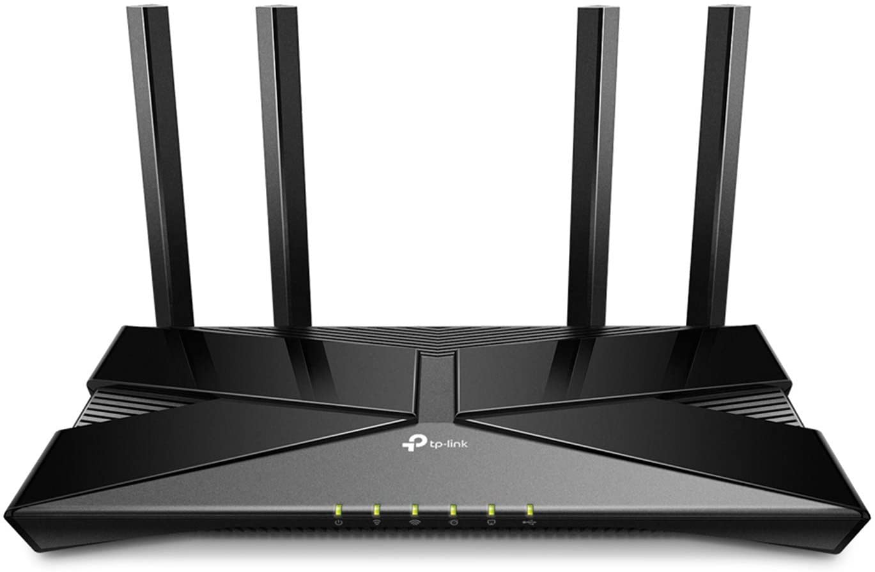
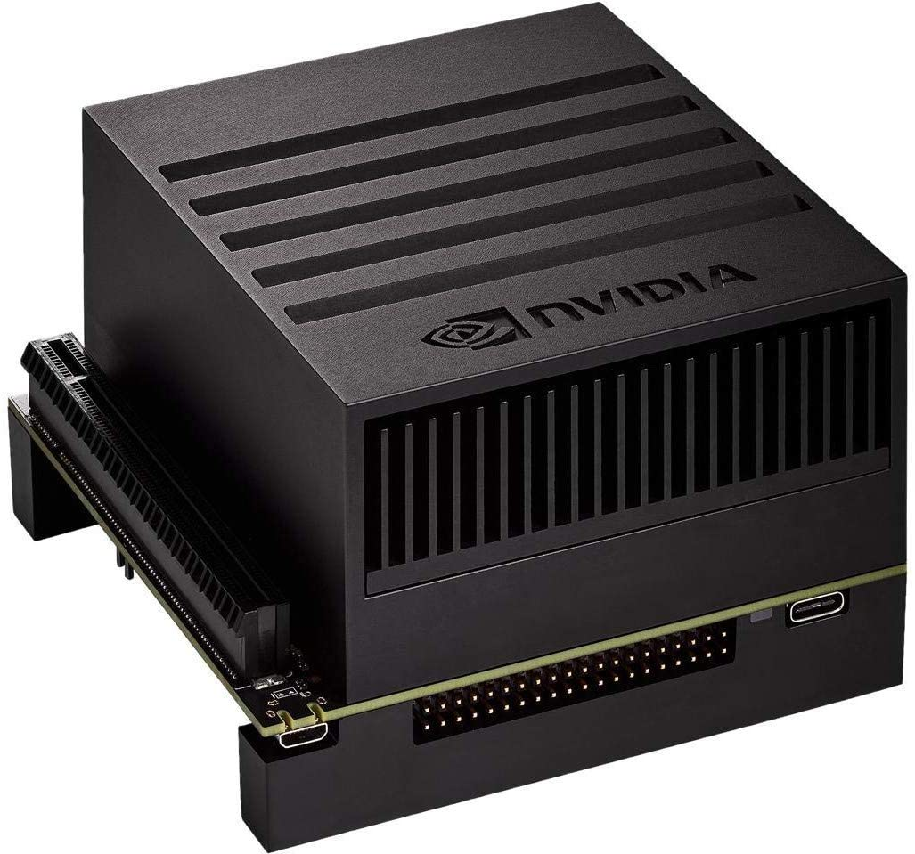
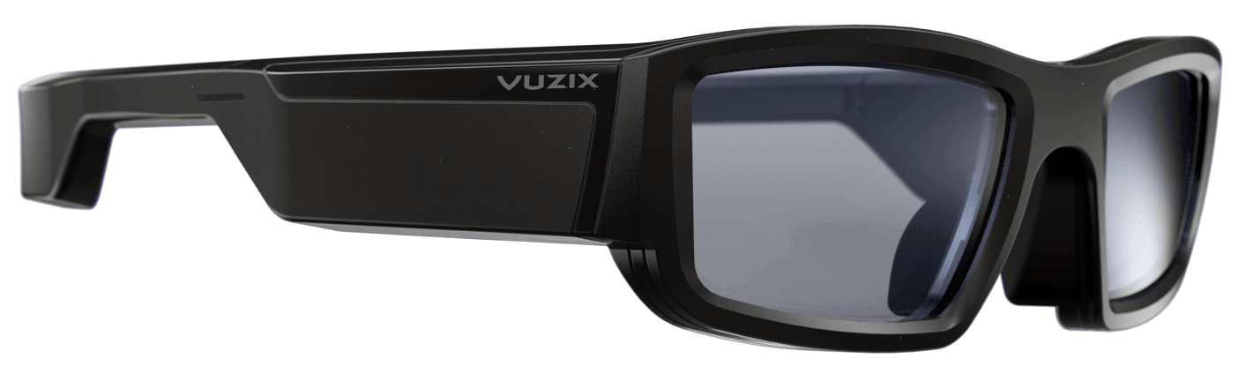
UNCC_WORK - Artificial Intelligence for powered augmented reality for workers
Damian Hupka
dhupka@uncc.edu
Zachary Zaleski
zzaleski@uncc.edu
Duncan Tennant
dtennan1@uncc.edu
William Clampett
wclampe1@uncc.edu
Nathan Pecoraro
npecorar@uncc.edu
Hamed Tabkhi (htabkhiv@uncc.edu)
Nabila Bousaba (nbousaba@uncc.edu)
Project Overview:
System Schematic:
System Design:
Server Design
Digital Twin Design:
Ensure safety of road workers by developing an alert system
Using AI Learning in the Xavier AGX, the system will detect dangers to workers.
Data aggregated is displayed on a mobile app digital twin
User defined area shown in red that will alert when client GPS location is outside the boundary
Current User GPS location shown on map inside application
Heart Rate
Alert
Requirements:
Project Deliverables:
Deliver a scalable backend communication system utilizing multithreading to achieve concurrency
Develop a digital twin application that will aggregate information of connected clients, while also using APIs to gather information about workzone surroundings
Equipment:
NVIDIA Jetson AGX Embedded Board
Vuzix Blade Goggles
Samsung Galaxy Watch Active
TP-Link Wireless AX1500 Access Point
Each device connected to the Xavier server will receive a risk score from the server and will send it’s GPS location as an acknowledgement that the risk score was properly received
The Xavier will then update risk scores based on the data and send those score and any relevant information to the digital twin
The server starts a new thread for each connected client
Every time the server sends or receives information from a client, a new thread is opened to ensure proper handling of any potential errors in communication
Future plans:
Include weather API into alert system
Refine app design and alert system using aggregated data and APIs
AI detection and Error Handling
On-site testing
Notes:
Zach

Slide 2
Project Overview
Ensure safety of road workers by developing an alert system
Using AI Learning in the Xavier AGX, the system will detect dangers to workers.
Data aggregated is displayed on a mobile app digital twin.
Notes:
Zach

Slide 3
Requirements:
Project Deliverables:
Deliver a scalable backend communication system utilizing multithreading to achieve concurrency.
Develop a digital twin application that will aggregate information of connected clients, while also using APIs to gather information about workzone surroundings.
Notes:
Cole

Slide 4
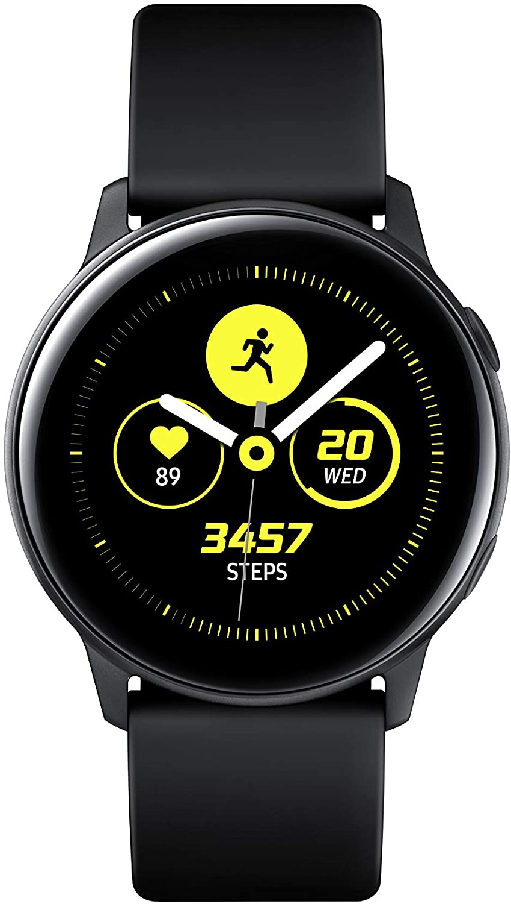
Equipment
NVIDIA Jetson AGX Embedded Board
Vuzix Blade Goggles
Samsung Galaxy Watch Active
TP-Link Wireless AX1500 Access Point
Notes:
Cole

Slide 5
System Schematic:
Notes:
Nathan

Slide 6
System Design:
Each device connected to the Xavier server will receive a risk score from the server and will send it’s GPS location as an acknowledgement that the risk score was properly received
The Xavier will then update risk scores based on the data and send those score and any relevant information to the digital twin
Notes:
Nathan

Slide 7
Server Design:
The server starts a new thread for each connected client
Every time the server sends or receives information from a client, a new thread is opened to ensure proper handling of any potential errors in communication.
Notes:
Damian

Slide 8
Digital Twin Design
User defined area shown in red that will alert when client GPS location is outside the boundary
Current User GPS location shown on map inside application
Heart Rate
Alert
Notes:
Duncan

Slide 9
Future Plans:
Include weather API into alert system
Refine app design and alert system using aggregated data and APIs
AI detection and Error Handling
On-site testing
Notes:
Damian

